Slide 1
How Do Vision Transformers Work?
201920811 이동현

Slide 2
Abstract
Properties of MSAs and ViTs
MSAs improve not only accuracy but also generalization by flattening the loss landscapes
MSAs and Convs exhibit opposite behaviors
Multi-stage neural networks behave like a series connection of small individual models
AlterNet
Conv blocks at the end of a stage are replaced with MSA blocks

Slide 3
Introduction
appropriate constraints may actually help - local MSAs
적절한 inductive bias가 좋다

Slide 4
MSA에 대한 의문점들
What properties of MSAs do we need to better optimize NNs? Do the long-range dependencies of MSAs help NNs learn?
Do MSAs act like Convs? If not, how are they different?
How can we harmonize MSAs with Convs? Can we just leverage their advantages?

Slide 5

Introduction
MSA = a trainable spatial smoothing of feature maps

Slide 6
Introduction
Their weak inductive bias disrupts NN training
a key feature of MSAs is their data specificity, not long-range dependency.
local MSAs outperforms global MSA because they reduce unnecessary degrees of freedom
적절한 inductive bias가 있는게 좋다

Slide 7
MSA 기존의 통념
성능 개선의 이유
weak inductive bias
capture of long-range dependencies
Small Data에는 불리하다
over-flexibility -> tendency to overfit
MSAs are merely generalized Convs
전부 사실이 아니다!

Slide 8
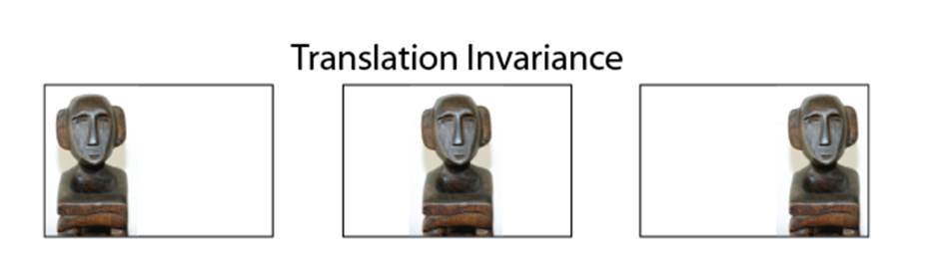
Inductive Bias
학습 시에는 만나보지 않았던 상황에 대해 정확한 예측을 하기 위해 사용하는 추가적인 가정
위치가 달라도 모양이 같으면 같은 물체이다

Slide 9
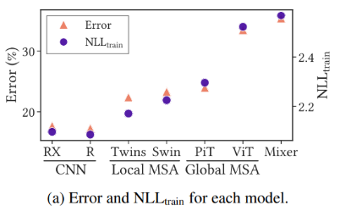
What Properties Of MSAs Do We Need To Improve Optimization?
The stronger the inductive biases, the stronger the representations (not regularizations)
stronger the inductive bias, the lower both the test error and the training NLL

Slide 10
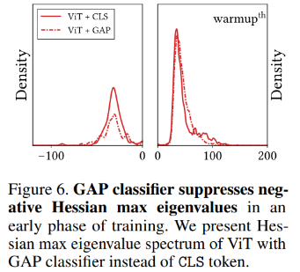
What Properties Of MSAs Do We Need To Improve Optimization?
Loss landscape smoothing methods aids in ViT training

Slide 11
What Properties Of MSAs Do We Need To Improve Optimization?
MSAs flatten the loss landscape
they reduce the magnitude of Hessian eigenvalues.
eigenvalues of ViT are significantly smaller than that of CNNs
While large eigenvalues impede NN training
In large data regimes, the negative Hessian eigenvalues disappears

Slide 12
MSA 기존의 통념
성능 개선의 이유
weak inductive bias -> 적절한 inductive bias가 있는 것이 좋다 | loss landscape를 flatten함
capture of long-range dependencies
Small Data에는 불리하다
over-flexibility -> tendency to overfit
MSAs are merely generalized Convs
전부 사실이 아니다!

Slide 13
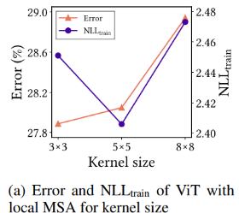
What Properties Of MSAs Do We Need To Improve Optimization?
A key feature of MSAs is data specificity (not long-range dependency)
long-range dependency and data specificity
long-range dependency hinders NN optimization
strong locality inductive bias
reduce computational complexity as originally proposed
aid in optimization by convexifying the loss landscape

Slide 14
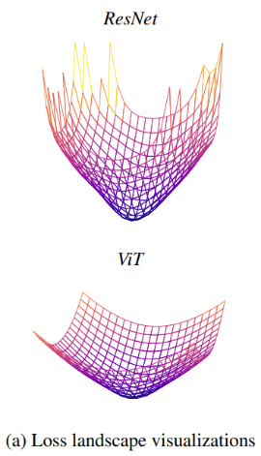
MSA의 장점
data specificity를 올려서 accuracy와 robustness 향상

Slide 15
MSA 기존의 통념
성능 개선의 이유
weak inductive bias -> 적절한 inductive bias가 있는 것이 좋다 | loss landscape를 flatten함
capture of long-range dependencies -> data specificity를 올림 | loss landscape를 convexify함
Small Data에는 불리하다
over-flexibility -> tendency to overfit
MSAs are merely generalized Convs
전부 사실이 아니다!

Slide 16
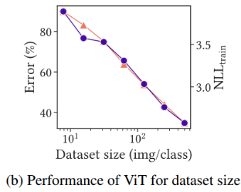
What Properties Of MSAs Do We Need To Improve Optimization?
ViT does not overfit small training datasets.
error & NLL 같이 오름
ViT’s poor performance in small data regimes is not due to overfitting

Slide 17
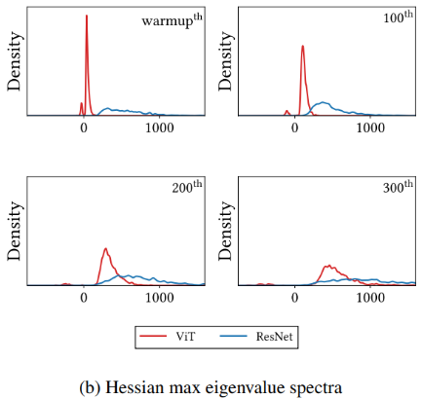
MSA의 단점
MSAs allow negative Hessian eigenvalues in small data regimes.
loss landscapes of MSAs are non-convex
non-convexity disturbs NN optimization

Slide 18
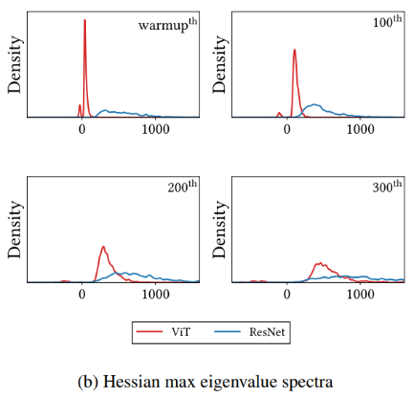
What Properties Of MSAs Do We Need To Improve Optimization?
ViT’s non-convex losses lead to poor performance

Slide 19
MSA 기존의 통념
성능 개선의 이유
weak inductive bias -> 적절한 inductive bias가 있는 것이 좋다 | loss landscape를 flatten함
capture of long-range dependencies -> data specificity를 올림 | loss landscape를 convexify함
Small Data에는 불리하다
over-flexibility -> tendency to overfit -> loss landscape가 non-convex하기 때문임
MSAs are merely generalized Convs
전부 사실이 아니다!

Slide 20
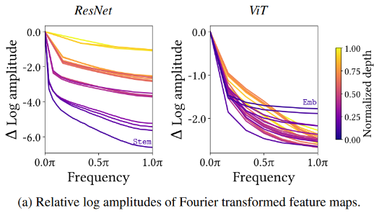
두 번째 의문
Do MSAs act like Convs?
→ exhibit opposite behaviors
MSAs aggregate feature maps, but Convs diversify them

Slide 21
세 번째 의문
How can we harmonize MSAs with Convs?
multi-stage NNs behave like a series connection of small individual models
MSAs are generalized spatial smoothings that complement Convs, not simply generalized Convs that replace conventional Convs

Slide 22
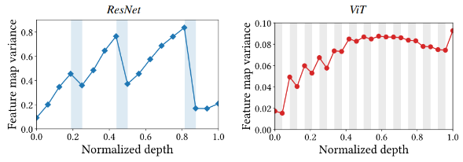
Do MSAs Act Like CONVs?
MSAs aggregate feature maps, but Convs do not.
MSAs (gray area) reduce the variance / Convs (white area) increase the variance.
reducing the feature map uncertainty helps optimization by ensembling and stabilizing the transformed feature maps

Slide 23
Do MSAs Act Like CONVs?
Convs are data-agnostic and channel-specific in that they mix channel information without exploiting data information.
MSAs are data-specific and channel-agnostic

Slide 24
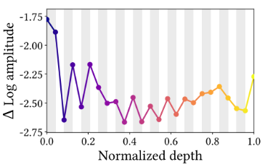
Do MSAs Act Like CONVs?
MSAs are low-pass filters, but Convs are highpass filters.
MSAs almost always decrease the high-frequency amplitude, and MLPs—corresponding to Convs— increase it.
The only exception is in the early stages of the model. In these stages, MSAs behave like Convs, i.e., they increase the amplitude

Slide 25
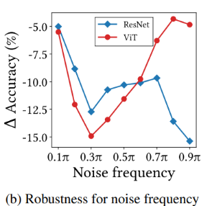
Do MSAs Act Like CONVs?
ViT는 low-frequency noise에 강함 / ResNet는 high-frequency noise에 강함
Low-frequency signals = shape / high-frequency signals = texture
MSAs are shape-biased / Convs are texture-biased

Slide 26
Do MSAs Act Like CONVs?
two additional patterns for feature map variance
the variance accumulates in every NN layer and tends to increase as the depth increases
the feature map variance in ResNet peaks at the ends of each stage
Therefore, we can improve the predictive performance of ResNet by inserting MSAs at the end of each stage
we also can improve the performance by using MSAs with a large number of heads in late stages.

Slide 27
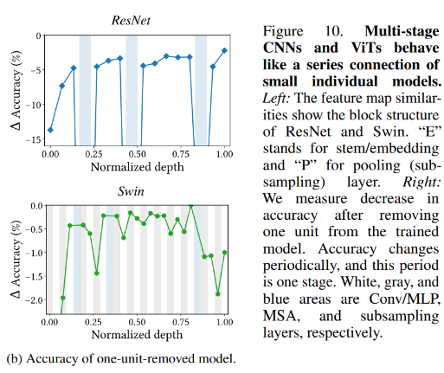
How Can We Harmonize MSAs With CONVs?
ResNet, 앞부분이 더 치명적 / Swin은 뒷부분이 더 치명적
MSAs closer to the end of a stage to significantly improve the performance

Slide 28
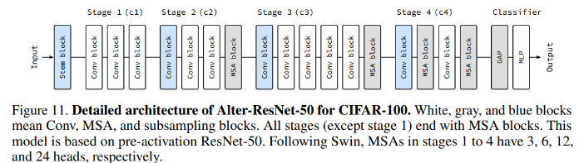
AlterNet
replace Conv blocks with MSA blocks from the end of a baseline CNN model
If the added MSA block does not improve predictive performance, replace a Conv block located at the end of an earlier stage with an MSA block
Use more heads and higher hidden dimensions for MSA blocks in late stages

Slide 29
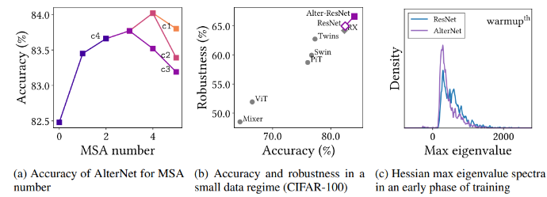
Performance

Slide 30
Discussion
MSAs are not merely generalized Convs
generalized spatial smoothings that complement Convs.
help NNs learn strong representations by ensembling feature map points and flattening the loss landscape

